Slide 1
CS302 Operating System Lab 10 File System
Xinxun Zeng, Shiqi Zhang,Chuang Yang

Slide 2
Overview
Concept: File, Directory, File System
File System Layout
contiguous allocation
linked allocation
indexed allocation

Slide 3
File System
File systems
Layer of OS that transforms block interface of disks (or other block devices) into Files, Directories, etc.
Keep track of files in secondary storage:
Organize files logically (directories)

Slide 4

File System Layout
File systems define a block size (e.g., 4KB)
Disk space is allocated in granularity of blocks
A “Master Block” determines location of root directory
Remaining disk blocks used to store files (and dirs)
There are many ways to do this

Slide 5
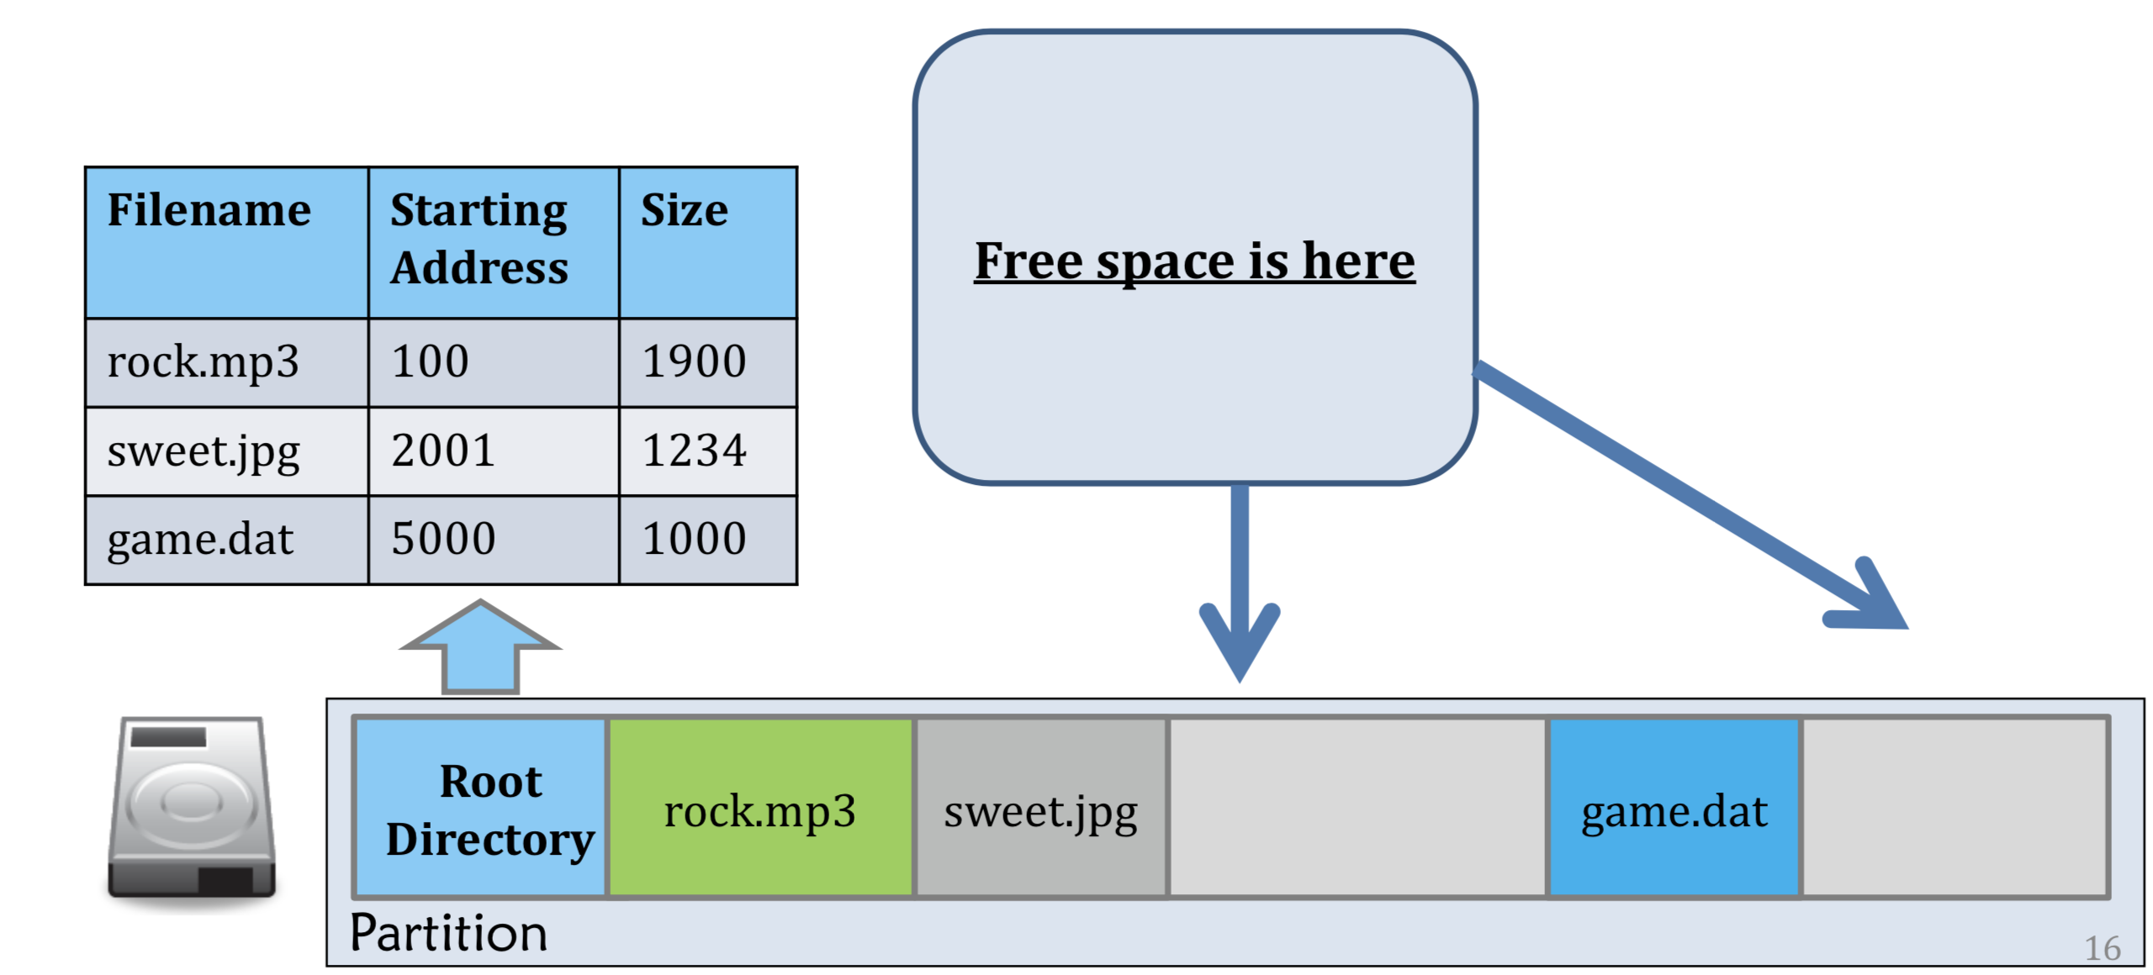
Contiguous Allocation
Contiguous allocation
Like main memory (base&bound)
Fast, simplifies directory access
Easy file deletion

Slide 6
Question
Which contiguous free block to be allocated ?
First Fit
Best Fit
Worst Fit
Notes:
File Control Block
随机读写是相对顺序读写而言的，所谓随机读写，是指可以在任何时候将存取文件的指针指向文件内容的任何位置。
顺序读写：文件指针只能从头移动到尾。
随机读写：文件指针可以随意移动，根据需要。
（1）在块 b 之后访问块 b+1 通常不需要移动磁头。当需要磁头移动（从一个柱面的最后扇区到下一个柱面的第一扇区）时，只需要移动一个磁道。
（2）对于直接访问一个文件的从块 b 开始的第 i 块，可以直接访问块 b+i.(在首地址上做偏移计算即可)

Slide 7
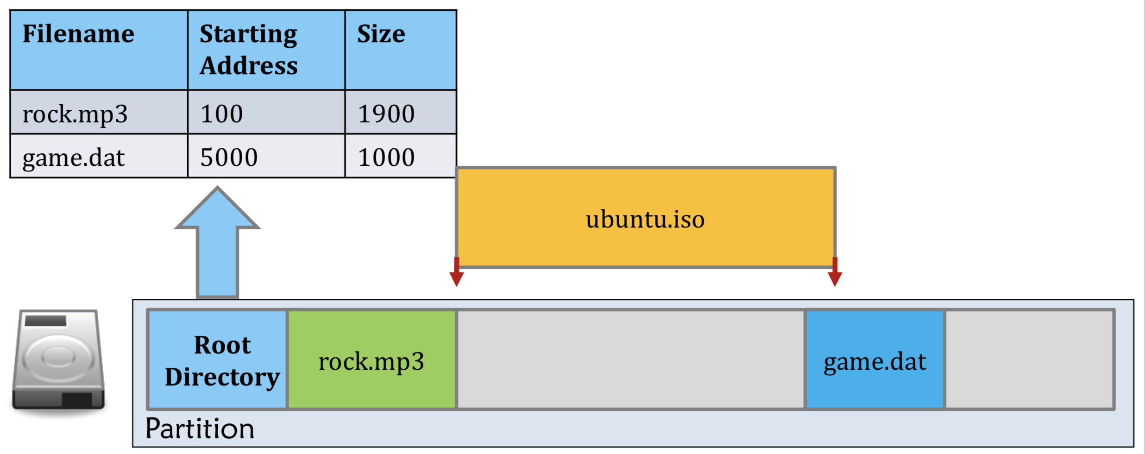
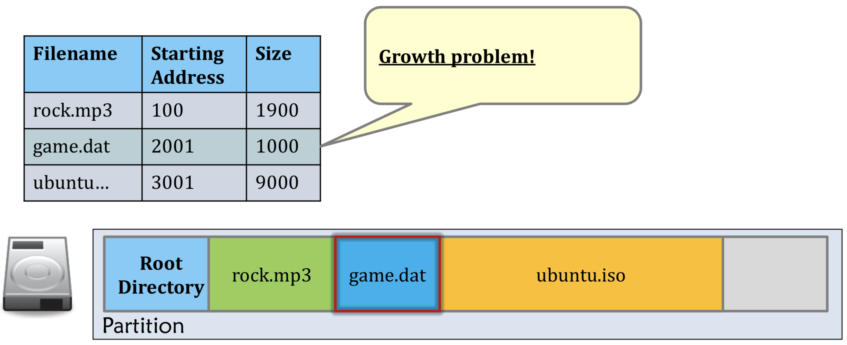
Question
What is the problem of Contiguous allocation ?
External fragmentation
Growth Problem
Notes:
File Control Block

Slide 8
Question
What is the advantage of Contiguous allocation ?
Fast Random access
Fast Sequential access
Notes:
File Control Block
随机读写是相对顺序读写而言的，所谓随机读写，是指可以在任何时候将存取文件的指针指向文件内容的任何位置。
顺序读写：文件指针只能从头移动到尾。
随机读写：文件指针可以随意移动，根据需要。
（1）在块 b 之后访问块 b+1 通常不需要移动磁头。当需要磁头移动（从一个柱面的最后扇区到下一个柱面的第一扇区）时，只需要移动一个磁道。
（2）对于直接访问一个文件的从块 b 开始的第 i 块，可以直接访问块 b+i.(在首地址上做偏移计算即可)

Slide 9
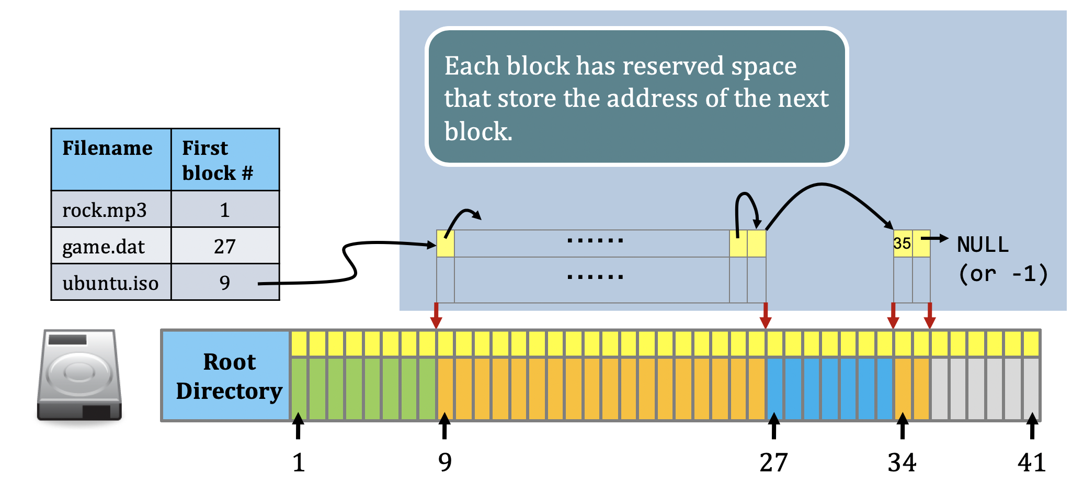
Linked Allocation
Linked Allocation
Each block points to the next, directory entry points to the first
Good for sequential access,
Solve external fragmentation and growth problem

Slide 10
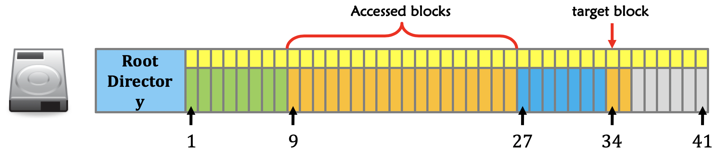
Question
What is the problem of Linked allocation ?
Bad for random access
Reliability
Space Wasting
Q: How to reduce space wasting ?
From Block to Cluster, a trade-off
Notes:
What if I want to access the 2019-th block of ubuntu.iso?
you have to access blocks 1 – 2018 of ubuntu.iso until the 2019-th block
如果指针需要使用 512 字节块的 4 字节，则 0.78% 的磁盘空间会用于指针，而不是其他信息。每个文件需要比原来稍多的空间。
除了上述还有其他问题需要解决。

Slide 11
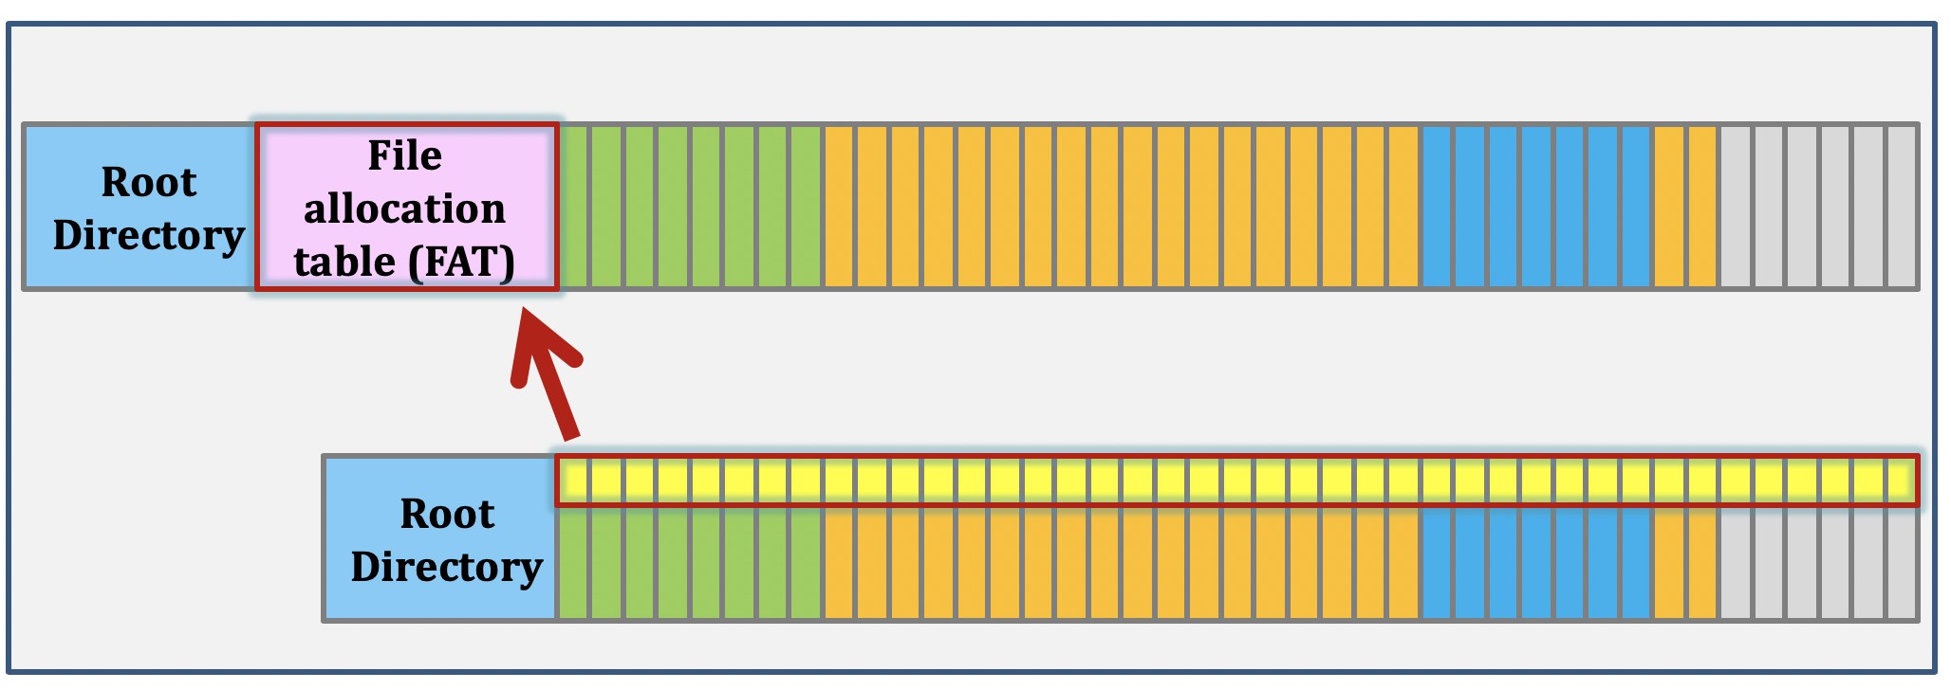
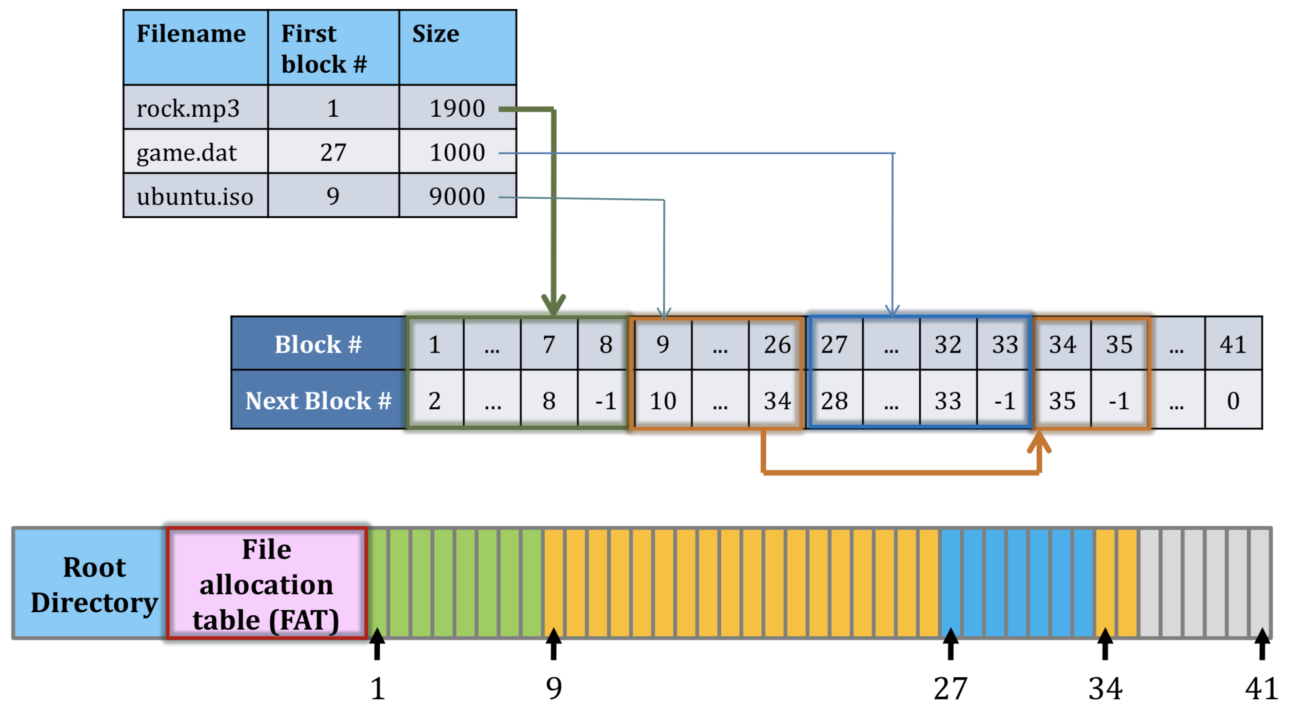
FAT, a variation of Linked Allocation
FAT Series: Centralize all the block links as File Allocation Table
struct node_type {
float data;
int next;
} node[100]
float node_data[100];
int node_next[100];
Notes:
The data, which is large (a disk block), is stored on disk; whereas, the next pointers, which are small (each is an integer) are stored in memory in a File Allocation Table or FAT. (When the system is shut down the FAT is copied to disk and when the system is booted, the FAT is copied to memory.)

Slide 12
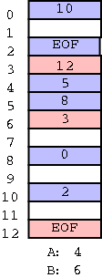
FAT, a variation of Linked Allocation
FAT Series: Centralize all the block links as File Allocation Table
Block Data, is stored on disk;
The next pointers, which are small (each is an integer) are stored in memory in a File Allocation Table or FAT.
When the system is shut down the FAT is copied to disk and when the system is booted, the FAT is copied to memory.
https://cs.nyu.edu/courses/spring09/V22.0202-002/lectures/lecture-23.html
struct node_type {
float data;
int next;
} node[100]
float node_data[100];
int node_next[100];

Slide 13
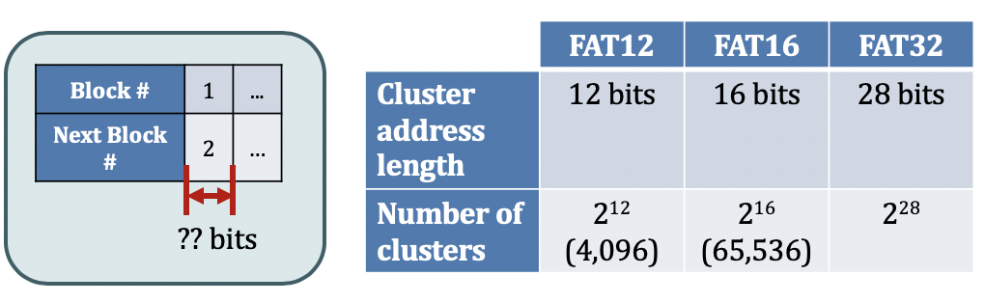
Question
What do 12, 16 and 32 mean in FAT12, FAT16 and FAT32
Block(cluster) address

Slide 14
Question
Although fasten the random access What is the problem of FAT?
Many file seeks unless entire FAT is in memory.
1TB (2^40 bytes) disk,
4KB (2^12) block size,
FAT has 256 million (2^28) entries.
If 4 bytes(32bit) used per entry ⇒ 1GB (2^30) of main memory required for FAT,
which is a sizeable overhead
http://www.cs.cornell.edu/courses/cs4410/2015fa/slides/10-filesystems.pdf
Notes:
For 4TB file system, 4kb block, how many entries do a FAT have? -----> 1G entries ----→ 8GB FAT

Slide 15
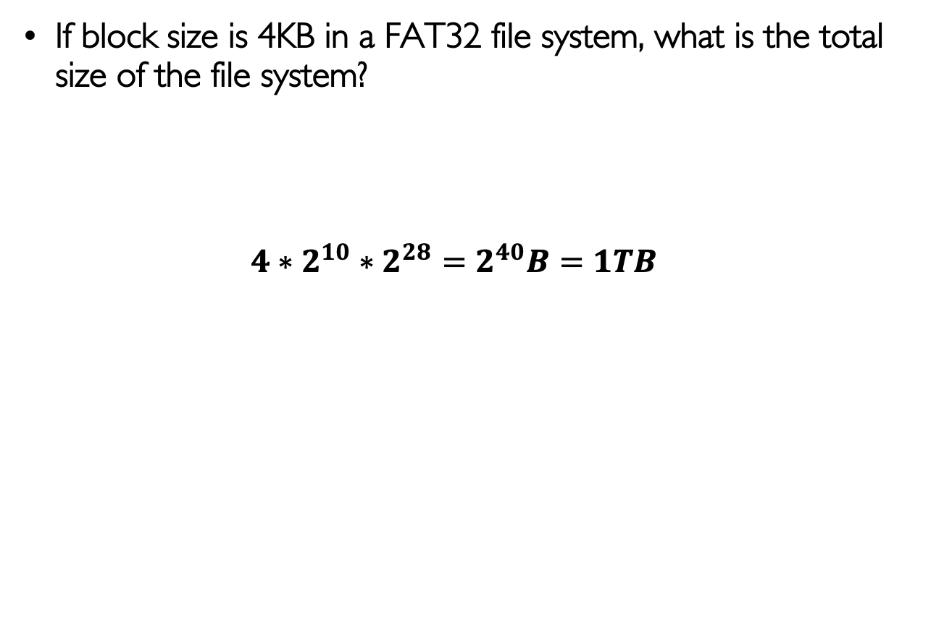
Question
If block size is 4KB in a FAT32 file system, what is the total size of the file system?
$$4∗2^{10}∗2^{28}=2^{40}B=1TB$$

Slide 16
File Permission (Linux)
Use ls –l filename to view the permission of a file
Permission mode
Owner and Group
Last modified
File Size
Hard link count
File Name

Slide 17
What is hard link?
Hard link count

Slide 18
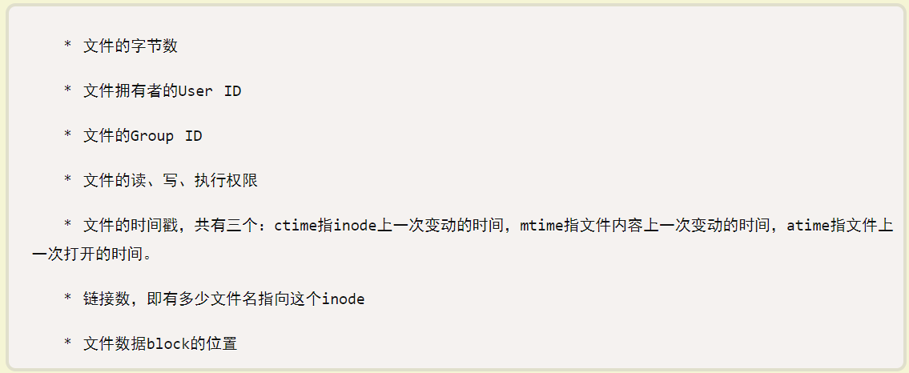
Background: INODE
INODE
Contains all info about a file(except filename and content)
Metadata of a file
http://www.ruanyifeng.com/blog/2011/12/inode.html
Notes:
Metadata of a file

Slide 19
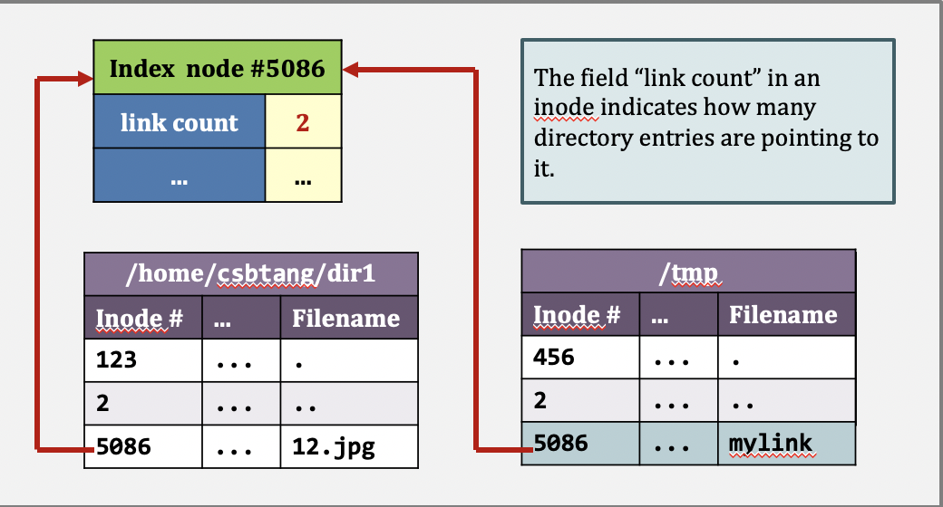
Hard Link
Each hard linked file is assigned the same Inode value as the original, therefore they reference the same physical file location.

Slide 20
Hard Link
Link to same inode
Removing any link, just reduces the link count, but doesn’t affect other links.
If original file is removed then the link will still show the content of the file.
Command to create a hard link is:

Slide 21
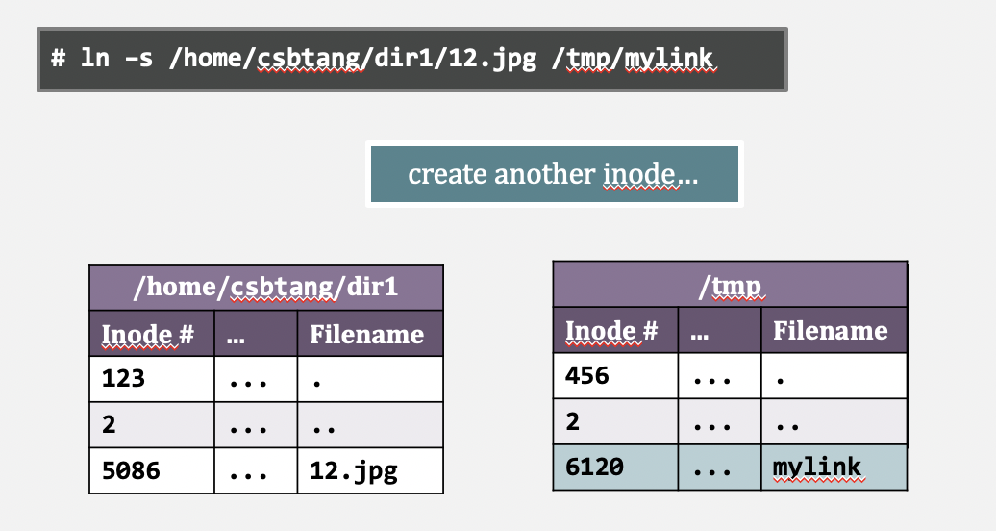
Soft Link
Each soft linked file contains a separate Inode value that points to the original file.
Notes:
文件A和文件B的inode号码虽然不一样，但是文件A的内容是文件B的路径。读取文件A时，系统会自动将访问者导向文件B。

Slide 22
Soft Link
Like file shortcut in Window OS
Link to same original file
If the original file is deleted or moved, the soft linked file will not work correctly (called hanging link).
Command to create a Soft link is:

Slide 23
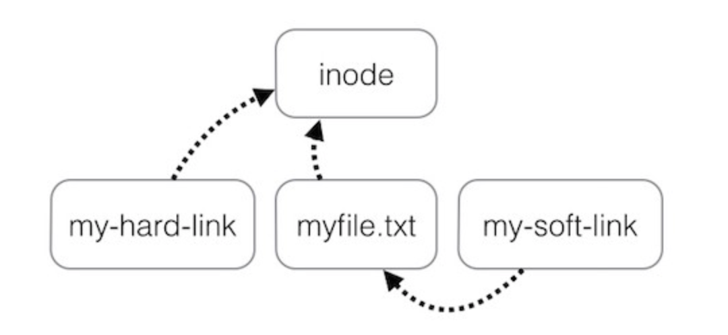
Hard Link and Soft Link

Slide 24
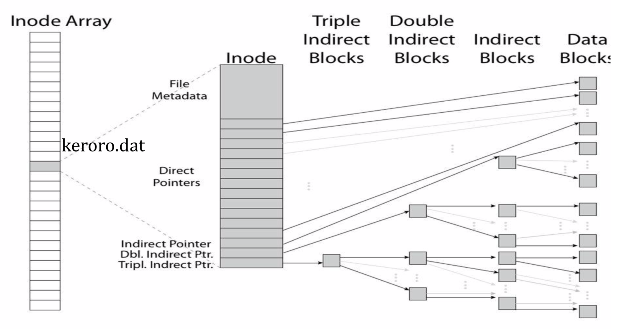
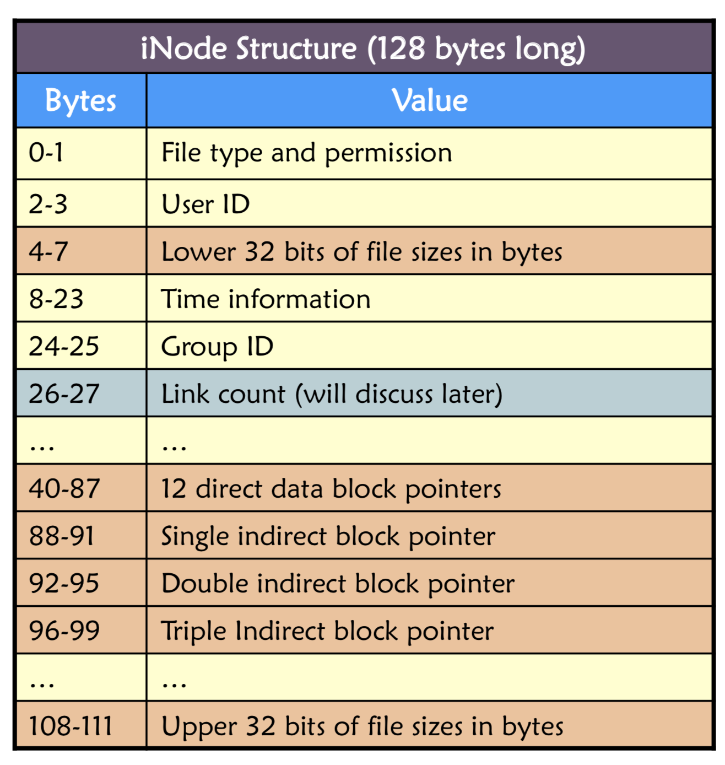
Indexed Allocation
Indexed Allocation(Unix Inode)
iNode Table is an array of iNodes
Handles random access better, still good for sequential

Slide 25
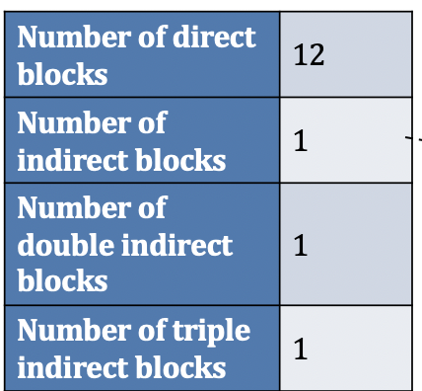
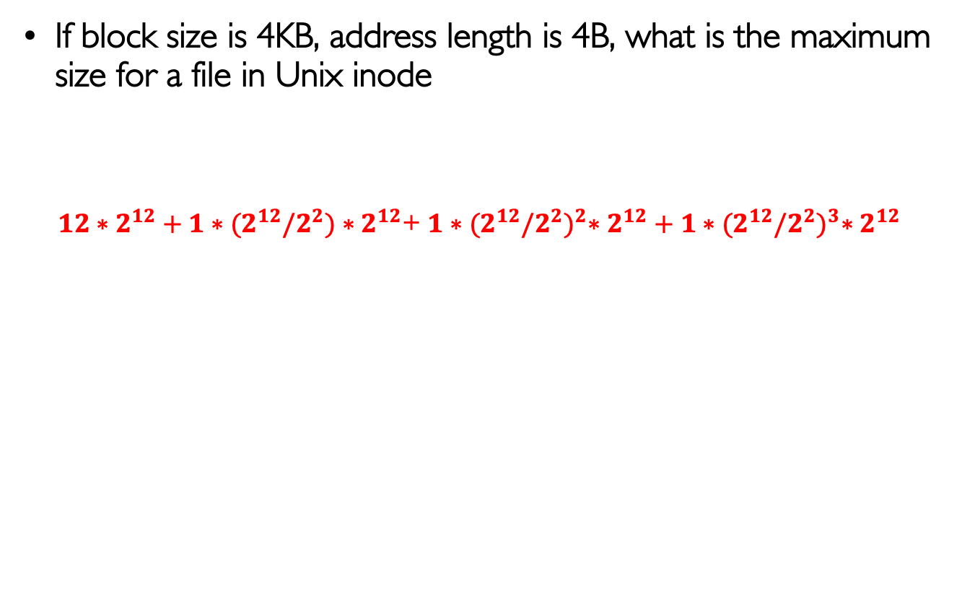
Question
If block size is 4KB, address length is 4B, what is the maximum size for a file in Unix inode
$12∗2^{12}+1∗{(2}^{12}/2^{2})∗2^{12}$+ $1∗{(2}^{12}{/2^{2})}^{2}∗2^{12}+1∗{(2}^{12}{/2^{2})}^{3}∗2^{12}$
Notes:
File size = number of data blocks * Block size

